Slide 1

Auto AI Model Building with IBM Watson Studio
This presentation provides a comprehensive guide to building AI models automatically using IBM Watson Studio. We will cover everything from initial setup and project creation to model deployment and testing, ensuring a clear understanding of each step in the process.
Made by: Riya Sirohi
Project: Auto AI Model with IBM Watson Studio

Slide 2
Agenda: Your Journey Through Auto AI
1
2
3
Introduction & Setup
Project Creation
Data Preparation
Understanding the basics and initial login procedures.
Setting up your workspace in Watson Studio.
Importing, uploading, and visualizing your datasets.
4
5
Model Training & Deployment
Testing & Integration
Building, saving, and deploying your AI models.
Accessing endpoints, testing predictions, and Google Colab integration.
MADE BY: RIYA SIROHI

Slide 3
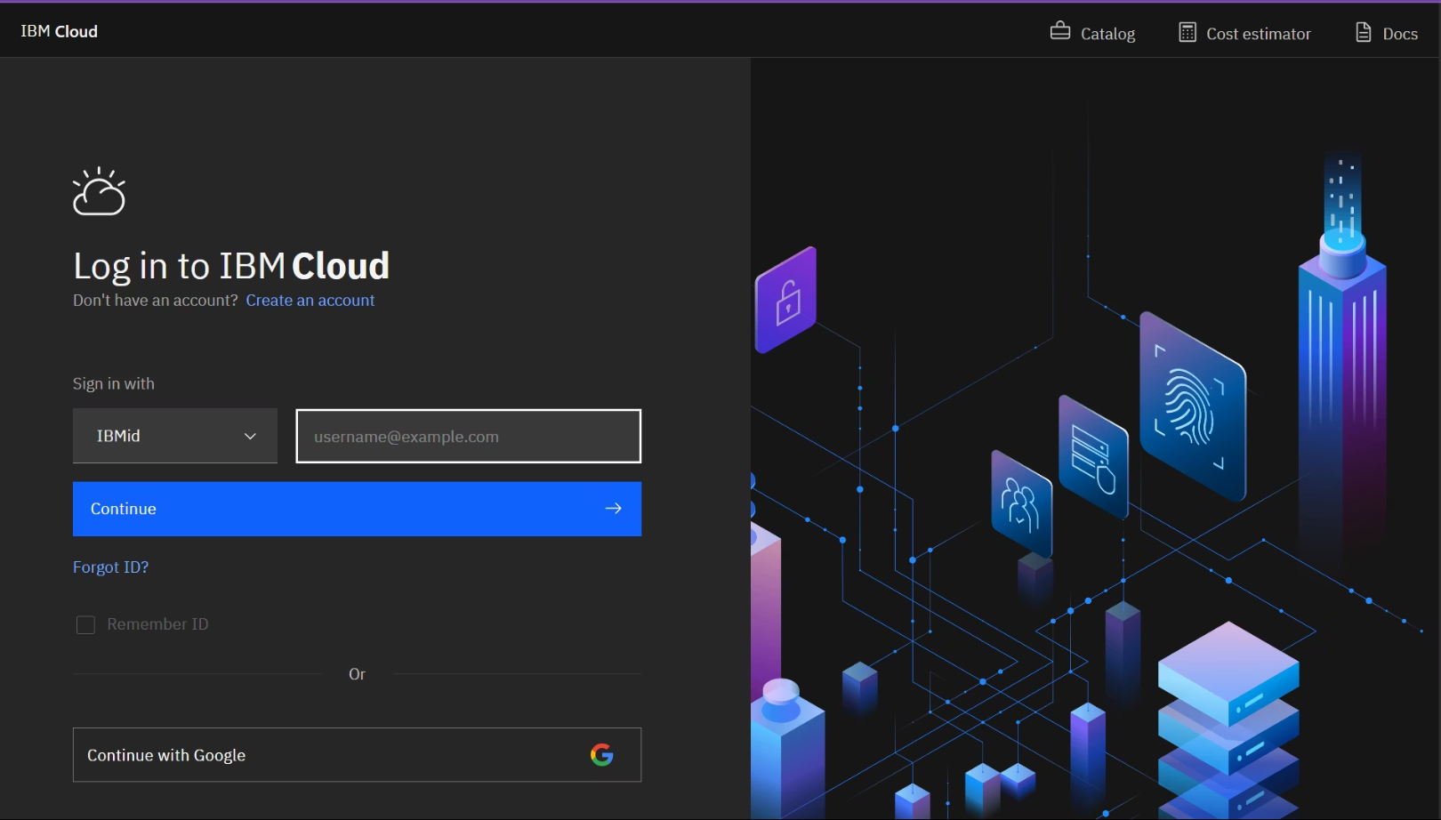
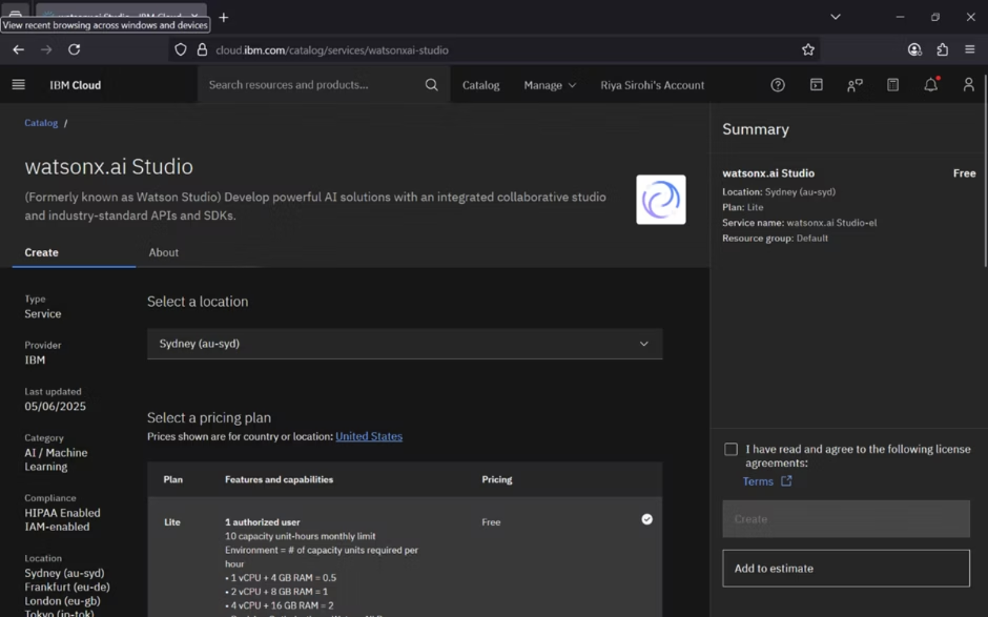
Getting Started: Login and Studio Setup
Step 1: Login to IBM Watson Studio
Step 2: Configure Watson.ai Studio
Begin by logging in with your IBM ID. Once authenticated, your dashboard will appear, from which you can search for and select "Watson.ai Studio" to proceed.
Upon selecting Watson.ai Studio, a creation window will prompt you to choose your location and plan. You can also rename your instance and must agree to the terms before creation.
MADE BY: RIYA SIROHI

Slide 4
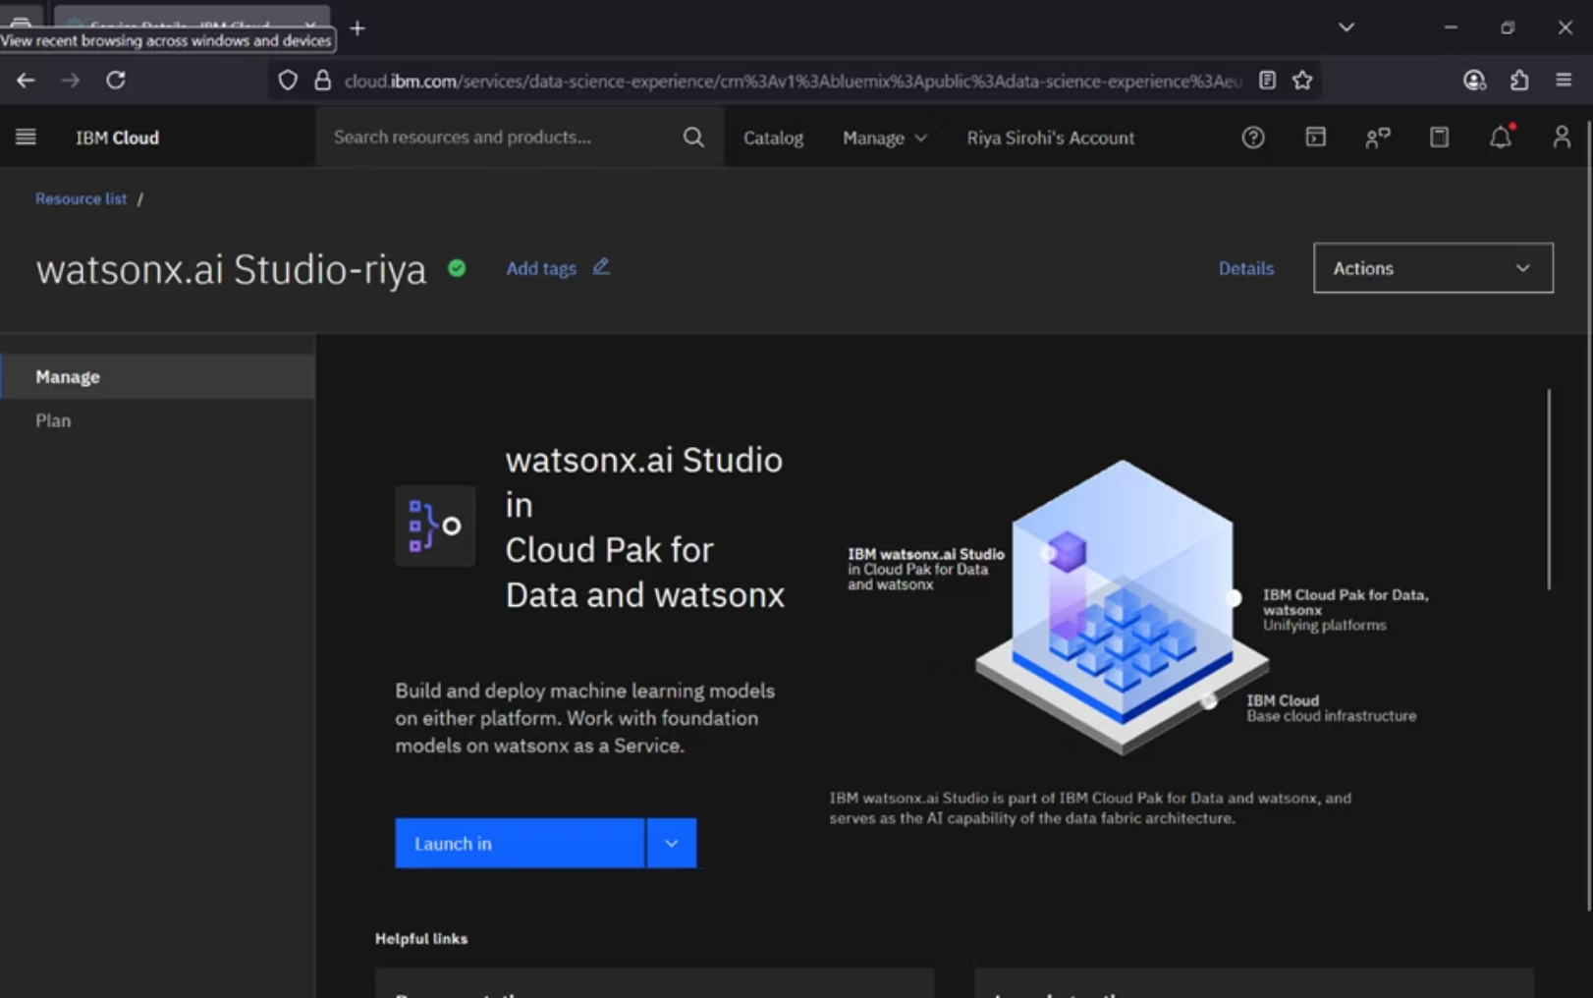
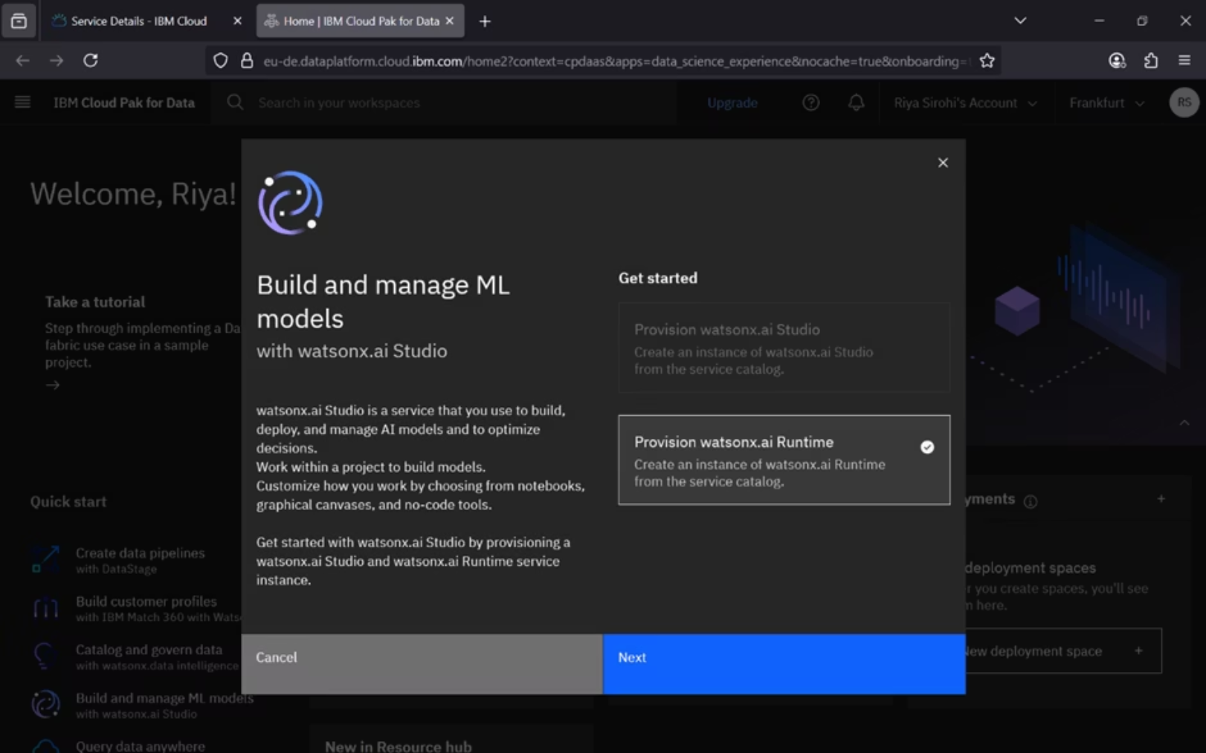
Launching Your Project via Cloud Pak
Step 3: Launch Watson Studio
Step 4: Resource Configuration
After creation, navigate to the "Manage" option. Here, you'll choose to launch Watson Studio via "Cloud Pak" to access the full suite of features for your AI projects.
A pop-up will appear; simply click "Next" to proceed. This step initiates the resource configuration process essential for your project's runtime environment.
MADE BY: RIYA SIROHI

Slide 5
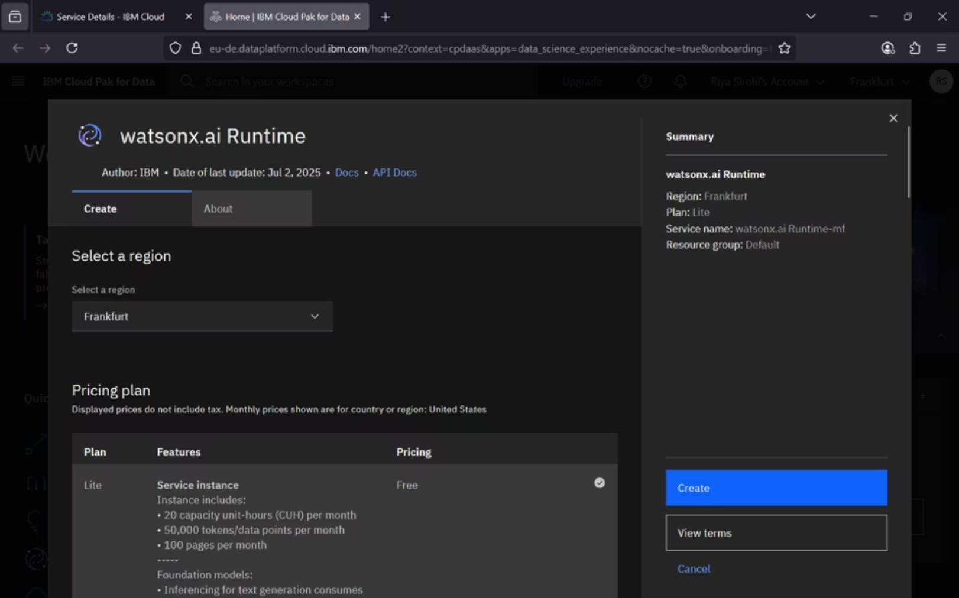
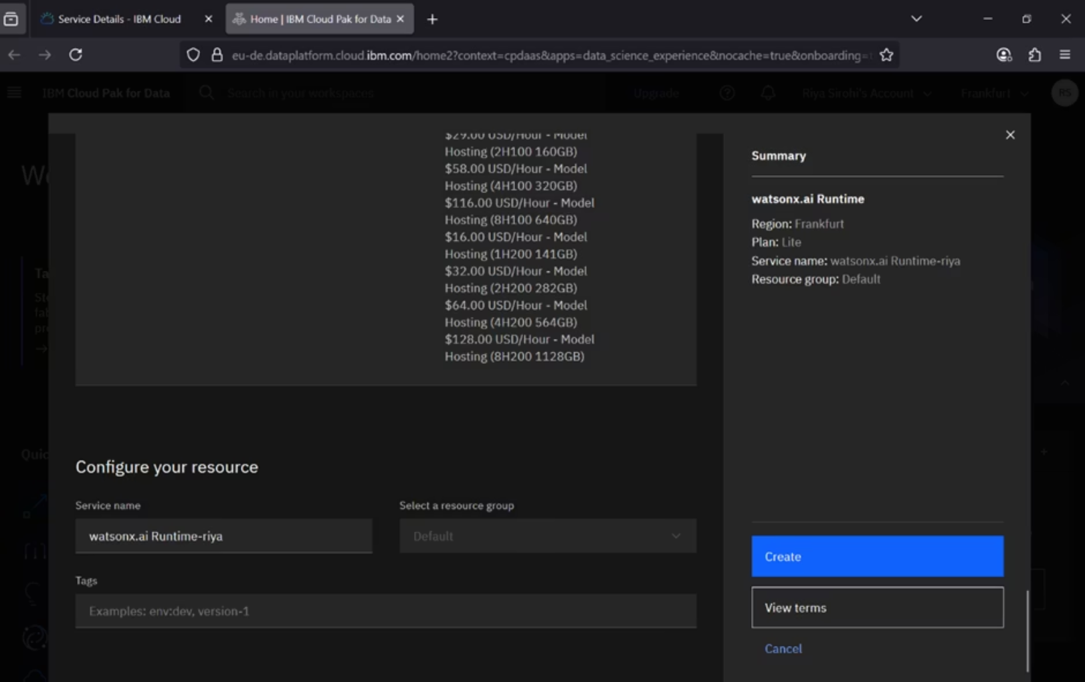
Creating and Managing Project Resources
Step 5: Create Watsonx.ai Runtime Resource
Step 6: Configure Resources
Select your region and plan, then rename and create your Watsonx.ai runtime resource. This resource is crucial for running your AI projects efficiently.
Configure the resources as specified in the previous step and finalize their creation. This ensures your project has the necessary computational power and environment.
MADE BY: RIYA SIROHI

Slide 6
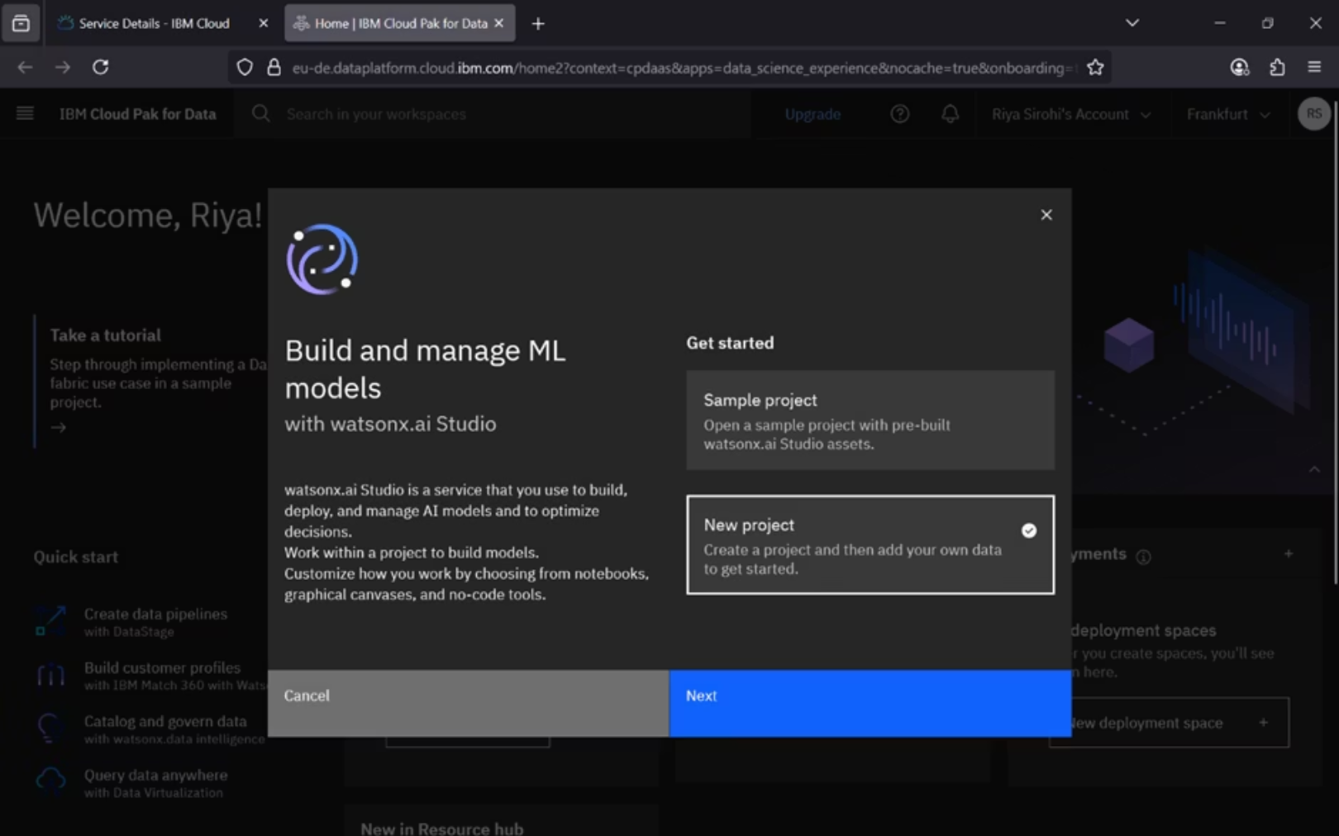
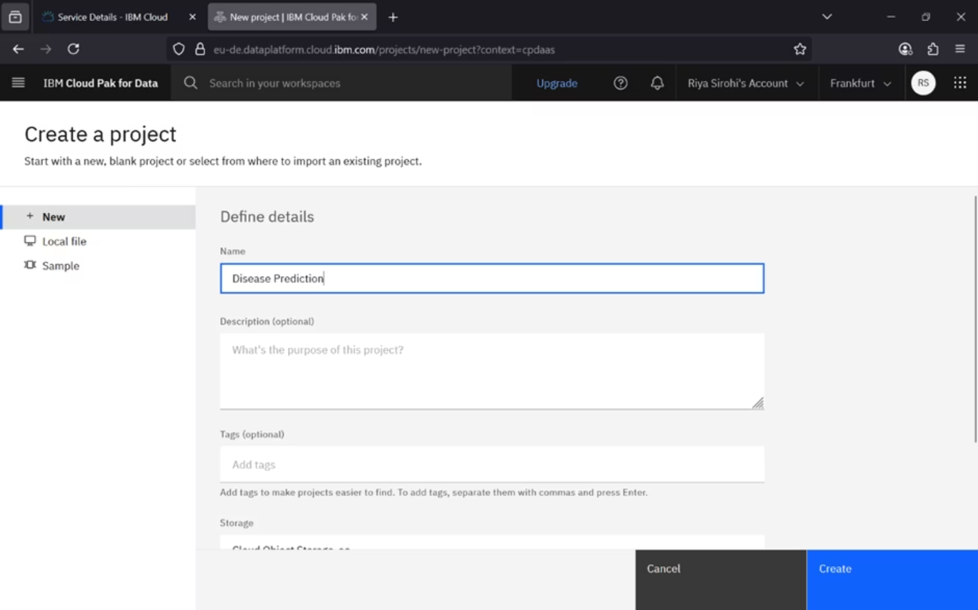
Initiating Your New AI Project
Step 7: Start a New Project
Step 8: Name Your Project
A pop-up window will prompt you to select "New Project." Click "Next" to begin the process of setting up your dedicated workspace for AI model building.
In the "Create a Project" window, provide a name for your project. You can optionally add a description and then click "Create" to finalize your project setup.
MADE BY: RIYA SIROHI

Slide 7





Project Dashboard: Your AI Command Center
The project dashboard is your central hub for all AI development activities. It offers various options to manage your project, data, and models.
Add Data
Collaborate with Users
Import and attach datasets you wish to build your models on.
Add friends or colleagues as collaborators to work together on the project.
2
1
Notebooks
3
Access Python or R notebooks for coding and data manipulation.
Assets & Resources
5
4
Auto ML
View all project assets and monitor resource usage.
Build machine learning models automatically without writing code.
MADE BY: RIYA SIROHI

Slide 8
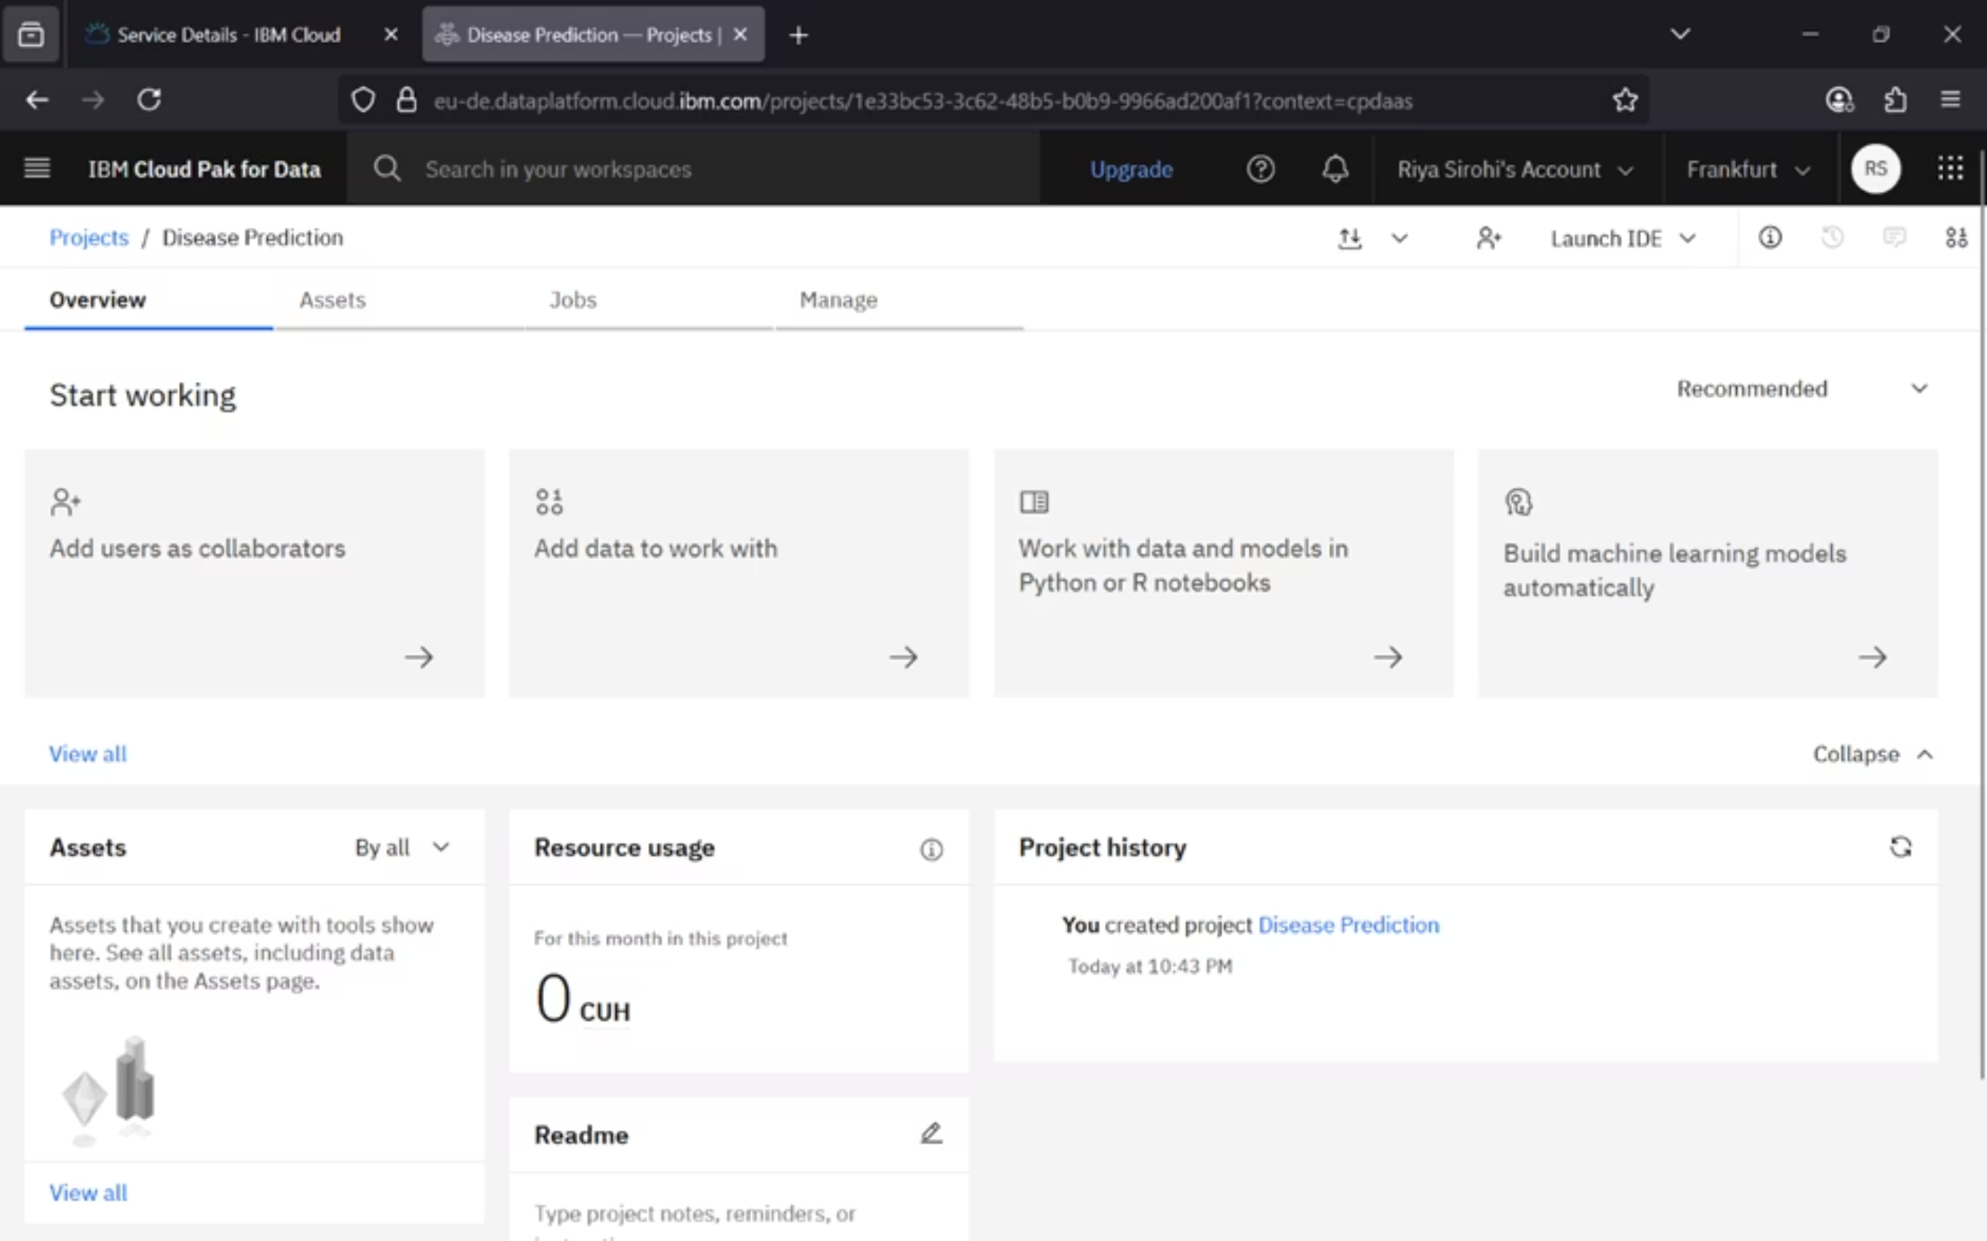
MADE BY: RIYA SIROHI

Slide 9
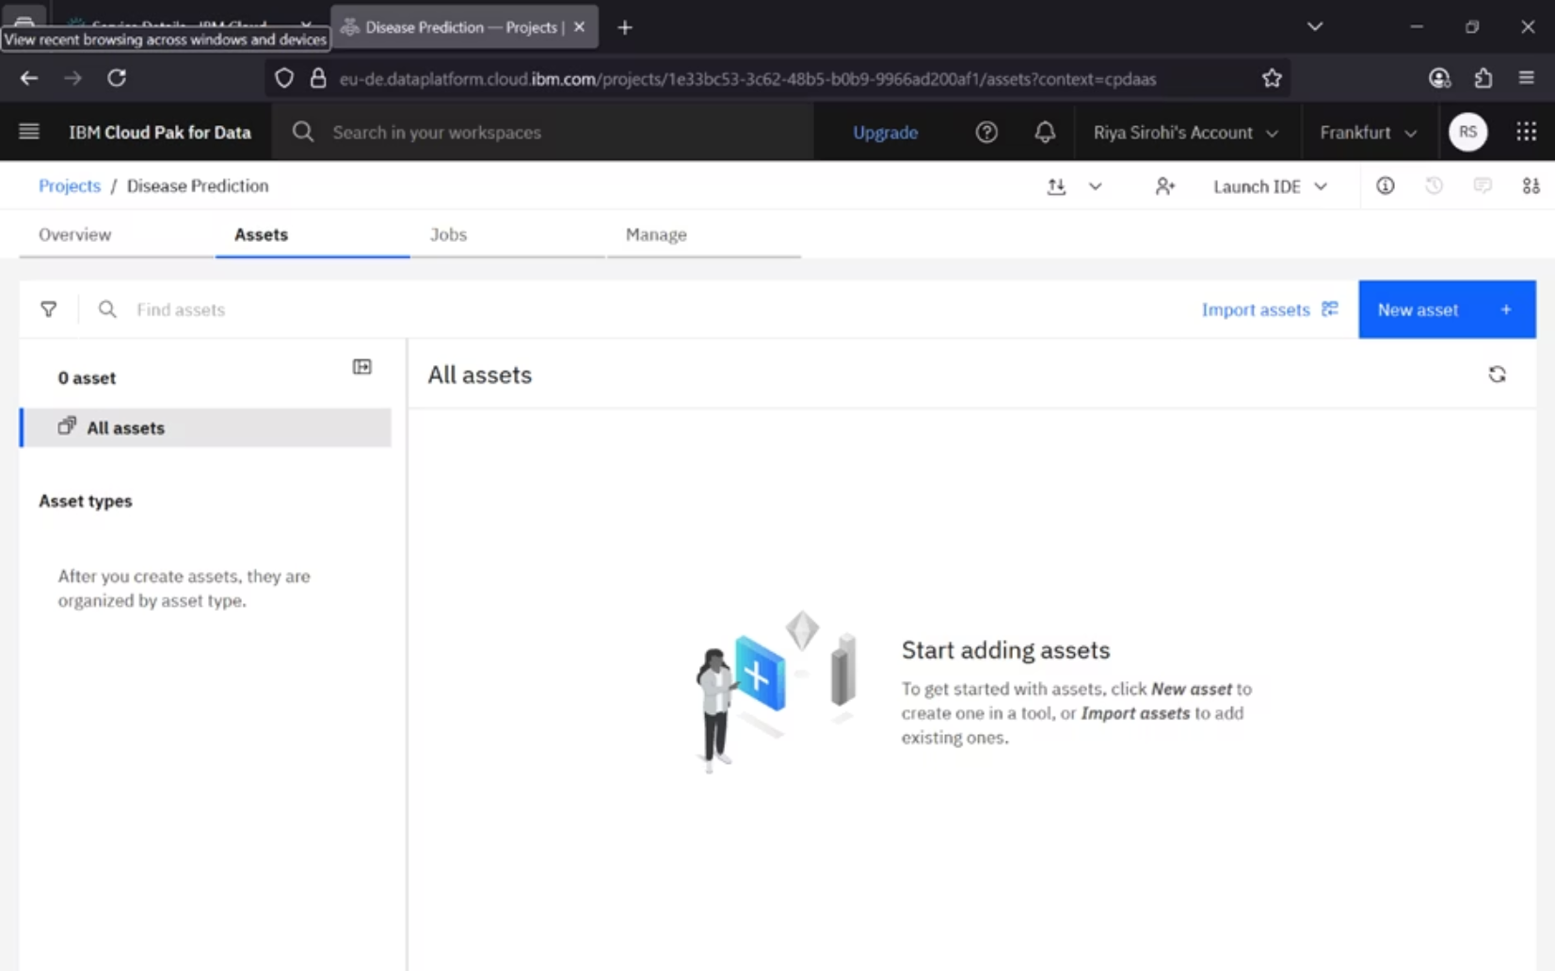
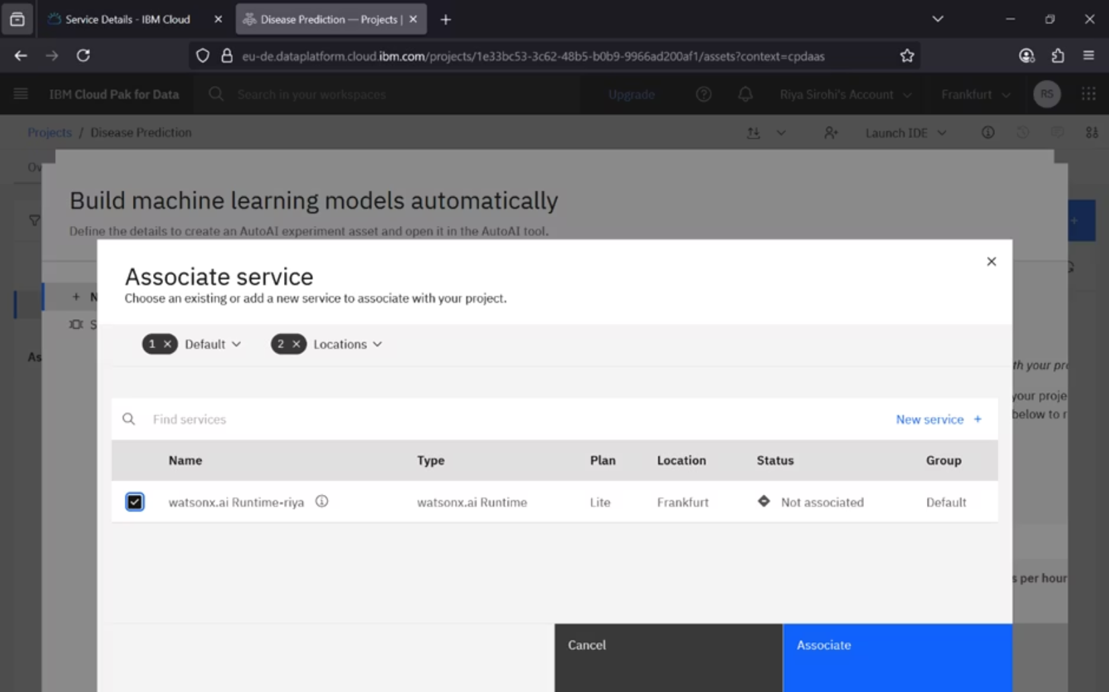
Data Preparation and Model Training
Import and Prepare Data
Associate Runtime & Create Model
Click "Add data to work with" or "Import assets" to upload your dataset. You can then use "Prepare and visualize data" to rename columns or change data types if needed.
Select your created runtime resource to associate it with your project. Then, click "Build Machine learning model automatically" to start the auto AI process.
Name your Auto AI project and create a User API Key, which will be generated in a new tab. This key is essential for secure access and integration.
MADE BY: RIYA SIROHI

Slide 10
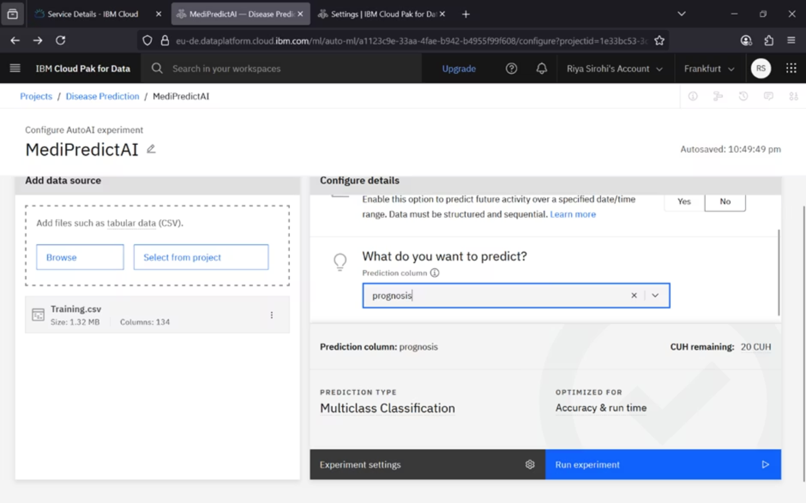
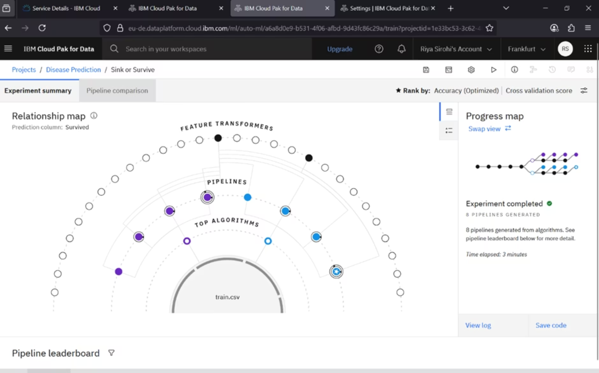
Creating Model and Training it
Create the Model
Train the Model
After your data is prepared, begin the AutoAI experiment by selecting your dataset. Then, define the prediction type (e.g., classification or regression) and specify the target column for your model.
Associate your project with the previously created runtime resource. Once configured, click to initiate the AutoAI process, which will automatically train and optimize various machine learning models.
MADE BY: RIYA SIROHI

Slide 11
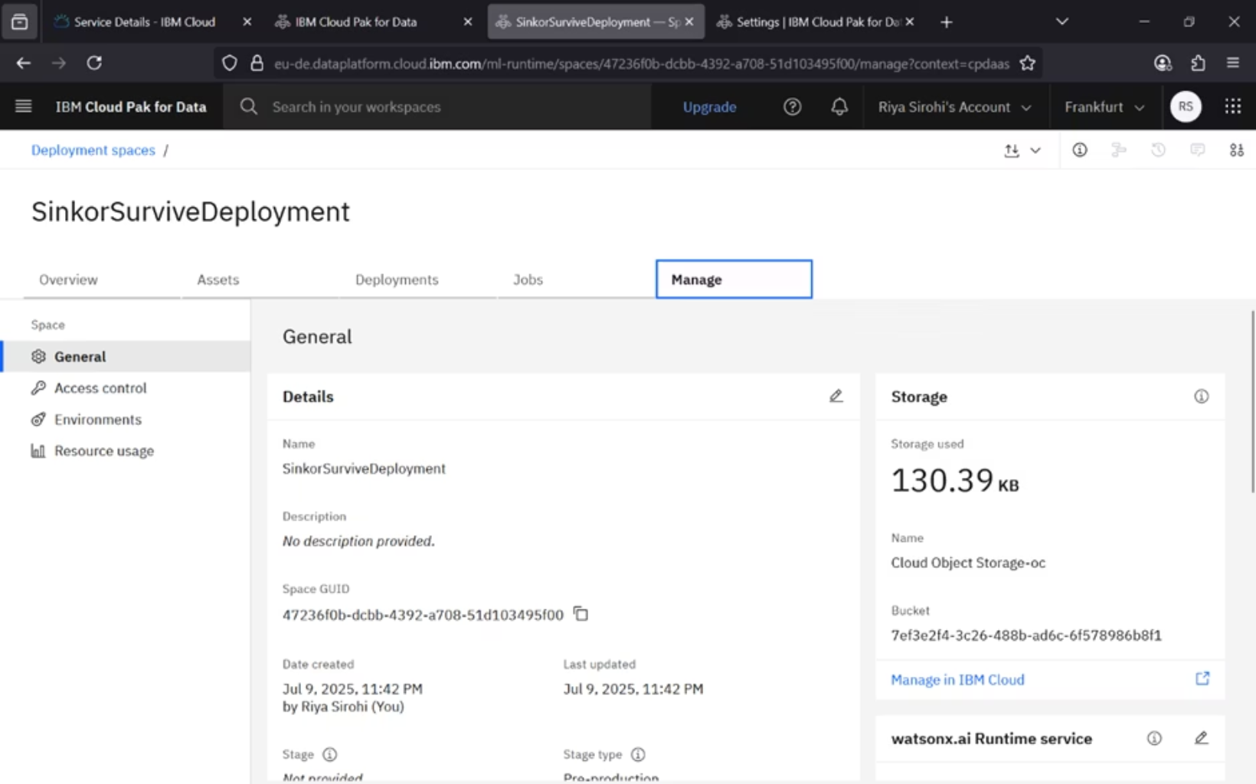
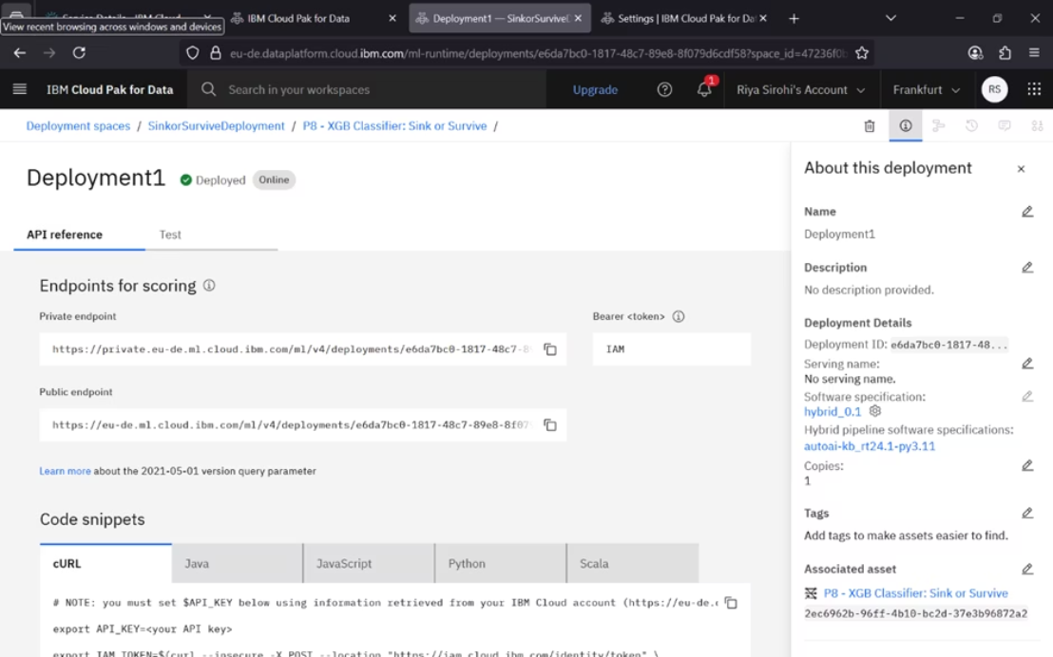
Model Deployment and Testing
Deploy Your Model
Test and Integrate
After training, select the best pipeline (e.g., Pipeline 8 with 83.3% accuracy) and save it as a model. Promote it to a new deployment space, naming it appropriately (e.g., "SinkorSurviveDeployment").
Create an online deployment. Access the scoring endpoints and code snippets (e.g., Python) from the API Reference. Test your model by uploading a CSV file and analyzing the prediction output and confidence levels. Integrate with Google Colab by copying the public endpoint link and API key into your Colab file, updating fields and values, and running the cell to get the scoring response.
MADE BY: RIYA SIROHI

Slide 12
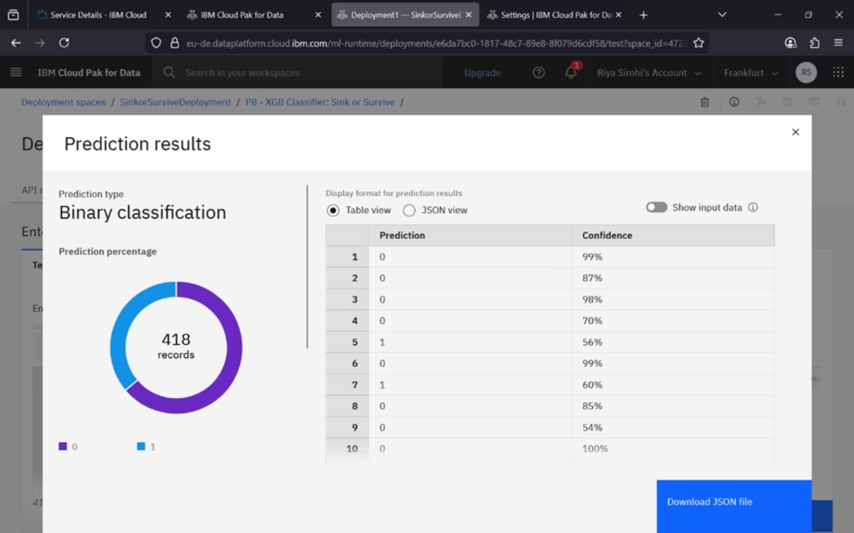
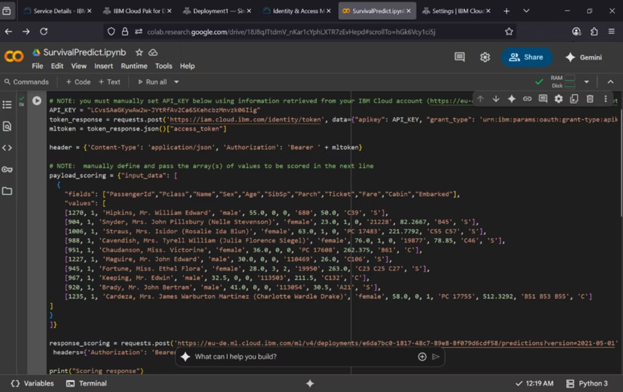
Final Output
Final Prediction
Integrating Model with Google Colab to run
After your model has been trained and deployed, the final prediction provides the classified outcome along with a confidence score. For instance, in a "Sink or Survive" model, the output would clearly indicate the predicted class (e.g., 'Survive') and the probability associated with that prediction (e.g., 83.3% confidence).
Once integrated with Google Colab using the public endpoint link and API key, you can execute your model directly from the notebook. Simply provide your input data within the Colab file, update the fields as necessary, and run the cell to receive immediate scoring responses, displaying the predicted outcomes and their corresponding confidence levels directly within your Colab environment.
MADE BY: RIYA SIROHI

Slide 13
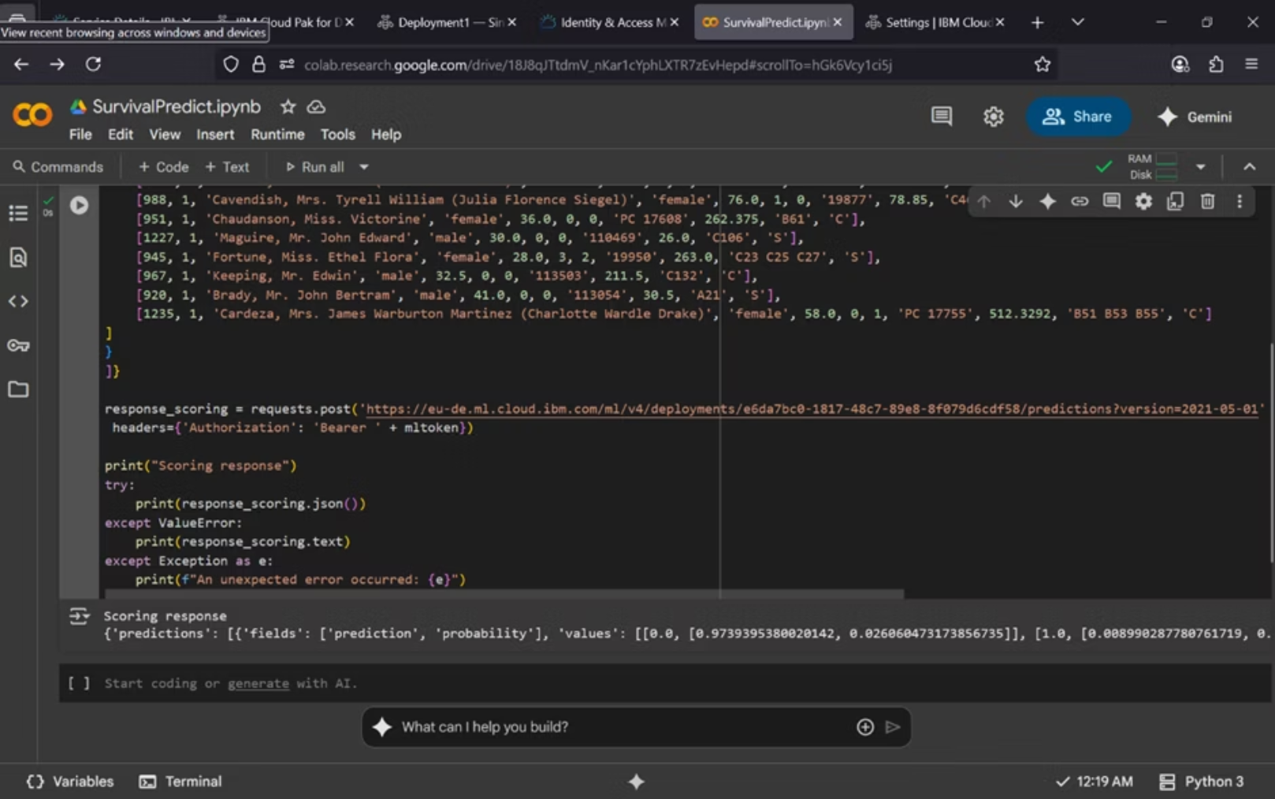
Final Output
Final Prediction
After your model has been trained and deployed, the final prediction provides the classified outcome along with a confidence score. For instance, in a "Sink or Survive" model, the output would clearly indicate the predicted class (e.g., 'Survive') and the probability associated with that prediction (e.g., 83.3% confidence).
MADE BY: RIYA SIROHI

Slide 14

Thank You!

